Slide 1
EASY Series IP cameras

Slide 2
Content
01
Product Family
02
Highlight Features
03
Advantages
04
OEM Housing

Slide 3
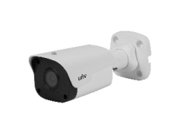
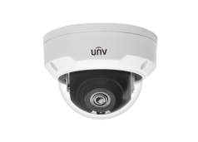
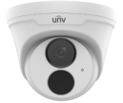
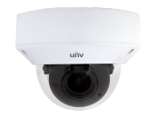
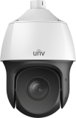
2MP Mini Fixed Bullet
2MP Vandal- resistant Fixed Dome
2MP Turret Fixed Dome
2MP VF Bullet
2MP Vandal- resistant
VF Dome
4MP Mini Fixed Bullet
4MP Vandal- resistant Fixed Dome
4MP Turret Fixed Dome
4MP VF Bullet
4MP Vandal- resistant
VF Dome
5MP Mini Fixed Bullet
5MP Vandal- resistant Fixed Dome
5MP Turret Fixed Dome
2MP 22x PTZ Dome

Slide 4
Content
01
Product Family
02
Highlight Features
03
Advantages
04
OEM Housing

Slide 5
H.265
U-Code
+
=
Ultra 265
Industrial Standard
Algorithm Innovation for bitrates control but keeps good image quality
Best H.265 solution that can save 75% of cost.

Slide 6
Excellent Image quality
Smart IR
Car-grade LED with Smart IR efficiently active IR compensation in totally dark scene
图片素材待补充
图片素材待补充
Smart IR OFF
Smart IR ON

Slide 7
Excellent Image quality
2D/3D
DNR
DNR
DNR technology helps reduce Noise on images and can display clear image at low light situation.
Static scene
Noise reduction between 2 frames
Keep clear image
Movement scene
Noise reduction in the frame
Keep smooth image
2D DNR
3D DNR

Slide 8
Reliability
Remove hardware optical coupler
Detect image brightness to control the IR cut
Software IR Control
More sensitive to detect illumination of image for realizing accurate day and night change
✶ Avoid extra cost of hardware failure
Notes:
Software IR control 对应的中文就是 智能光敏技术
具体第8页幻灯片相关技术可参考 智能光敏胶片

Slide 9
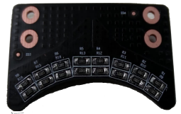
Navigator PTZ
Powerful Engine
Intelligent temperature control
Stepping motors driving PTZ moves stably and smoothly without jerk at 300 degrees per second for stable video
Built-in heater removes cover on lens automatically
300°/s
1024 Presets
No noise
✶ Anti-fog and ice
✶ All Weather reliable

Slide 10
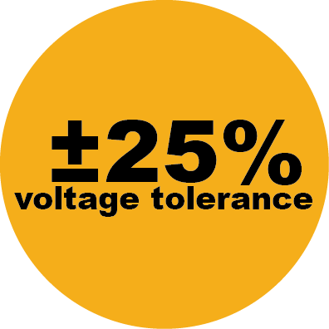
Reliability
Water proof
✶ IP67/IP66
Wide temperature
IK10 Vandal proof
Extreme operation temperature test for all outdoor products
℃
±25% wide voltage tolerance
idea for power instability

Slide 11
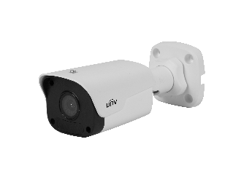
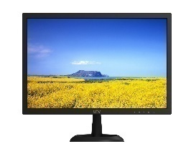
Easy to use
Dual-stream
Dual-stream can help store videos in two different bitrates for multiple uses.
✶ Sub-stream transmission with low bitrates for better display performance
NVR
Internet
✶ Main stream storage with high bitrates

Slide 12
Easy to use
Plug & Play
Support Plug & Play with Ultra265 IPC and NVR
SD card & ANR
SD card for Edge storage
Upload video in SD card after network reconnection
Cloud Upgrade
✶ Upgrade all IPC/NVR over Cloud
Compatibility
One-click Add
Support Onvif (Profile S /G), LAPI and SDK
✶ Easy to add IPC as operating NVR
Compatibility

Slide 13
Content
01
Product Family
02
Highlight Features
03
Advantages
04
OEM Housing

Slide 14
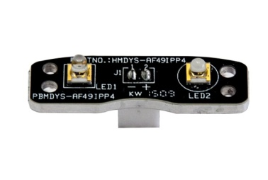
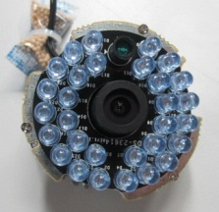
Car-grade LED
2 High-powered car-grade LEDs support 30m IR hence increasing light compensation.
图片素材待补充
图片素材待补充
Uniview Car-grade LED
Competitors’ LED

Slide 15
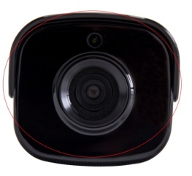
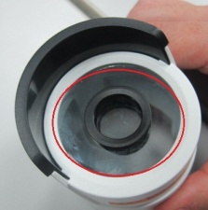
IR anti-reflection glass
8% infrared transmittance increase
Apart from increasing infrared transmittance, anti-reflection glass also can repel insects gathering at night.
93%
85%
Uniview anti-reflection glass
Competitors’ glass

Slide 16
Content
01
Product Family
02
Highlight Features
03
Advantages
04
OEM Housing

Slide 17
Material
1
 | 2MP | 4MP | 5MP
① | Plastic | Plastic | Plastic
② | Metal | Metal | Metal
③ | Metal | Metal | Metal
3
2

Slide 18
Material
1
 | 2MP | 4MP | 5MP
① | Metal | Metal | Metal
② | Plastic | Plastic | Plastic
2

Slide 19
Material
1
 | 2MP | 4MP | 5MP
① | Plastic | Metal | Metal
② | Metal | Metal | Metal
③ | Plastic | Plastic | Plastic
④ | Plastic | Plastic | Plastic
2
3
4

Slide 20
One more thing

Slide 21
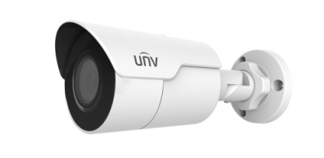
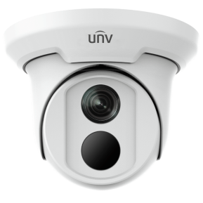
4K fixed lens IPC
See more with Less
4K series with Ultra 265 high resolution with lower bitrate and storage
1/2.5” 8MP (3840×2160) @ 15fps
WDR 120dB
IP67
Smart functions: Face detection, intrusion detection, crossing line detection, scene change, audio exception, defocus detection, auto tracking.
IPC2128SR3-DPF40（60）
2D DNR
IPC3618SR3-DPF28 (40)

Slide 22
Better Security, Better World

