Slide 1
NVR MagLev Fan Upgrade Notification

Slide 2
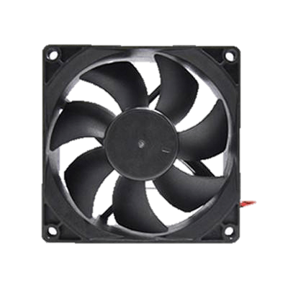
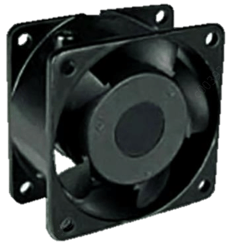
Overview
The chassis fan applied to NVR will be upgrade to maglev fan for the purpose of extending service life of device and reduce working noise.
Product effected
1/2 HDD(s) PoE NVR
2 HDDs NVR
Service life
Regular Fan
Maglev Fan
Working noise

Slide 3
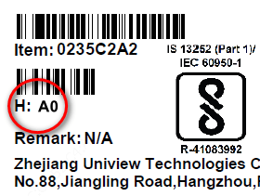
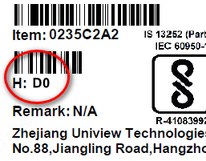
Version
Model | Version
NVR301-04-P4 | D0
NVR301-04L-P4 | C0
NVR301-08-P8 | D0
NVR301-08L-P8 | C0
NVR301-16-P8 | D0
NVR301-16L-P8 | C0
Model | Version
NVR302-08E-P8-B | D0
NVR302-16E-P16-B | D0
NVR302-16E-P8-B | D0
NVR302-09E-B | D0
NVR302-16E-B | D0
Label sample
Note: The picture is for reference only.
Please be subject to the actual products.

Slide 4
Schedule
Time | Models | Status | Comment
May 2018 | NVR301-04-P4、NVR301-04L-P4、NVR301-08-P8、NVR301-08L-P8、NVR301-16-P8、NVR301-16L-P8 | Ready | 1 HDD PoE NVR
July 2018 | NVR302-08E-P8-B、NVR302-16E-P16-B、NVR302-16E-P8-B | Ready | 2 HDDs PoE NVR
Oct 2018 | NVR302-09E-B、NVR302-16E-B | Progressing | 2 HDDs NVR
Note: device delivered might be mixed by default due to inventory consuming.

Slide 5
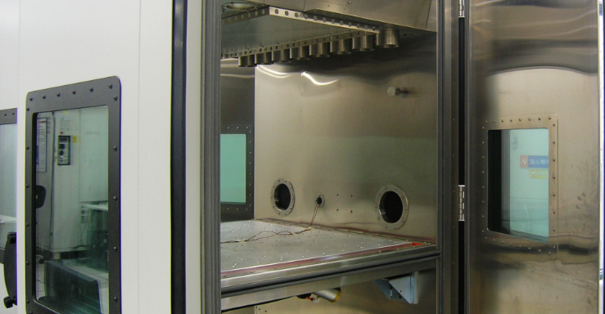
Rigorous R&D Test
37
Product level functional tests
201
Product tests
8
System reviews
418
Board tests
22
Environment and reliability tests
Rigorous temperature tests are conducted to guarantee the device is working properly without fan.
Uniview scrutinize every element and chip, carefully selected all materials.
Each detail was meticulously designed, engineered, and crafted until products had the industry-leading quality.

Slide 6
Better Security, Better World

